Slide 1
Tour de Table - Transposition of the European Accessibility Act in German Law
Legal Affairs Committee
Friday, 13 Mai 2022
Agnes Freise

Slide 2
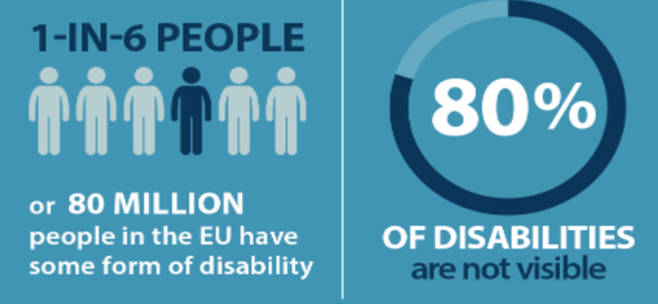
Tour de Table - Transposition of the European Accessibility Act in German Law
European Accessibility Act (EAA)
Directive of EU, proposed in 2011, came into force in 2019.
Persons with disabilities and elderly people should benefit from having more accessible products and services:
consumer banking services (also credit agreements covered by CCD or MCD, Art. 3 para 28a EAA)
e-commerce services (= services provided at a distance, through websites /mobile device-based services by electronic means and at the individual request of a consumer with view to concluding a consumer contract (Art. 3 para 29 EAA)
Services have to comply with the accessibility requirements in Annex I, Sections III and IV (Art. 4 para 1 EAA).

Slide 3
Tour de Table - Transposition of the European Accessibility Act in German Law
General accessibility requirements related to all services (Annex I, section III EAA)
(b) providing information about functioning of the service, and where products are used in the provision of the service, its link to these products as well as information about their accessibility characteristics and interoperability with assistive devices:
(i) making the information available via more than one sensory channel;
(ii) presenting the information in an understandable way;
(v) presenting in fonts of adequate size and suitable shape, taking into account foreseeable conditions of use and using sufficient contrast, as well as adjustable spacing between letters, lines and paragraphs;
(c) making websites, including the related online applications, and mobile device-based services, including mobile applications, accessible in a consistent and adequate way by making them perceivable, operable, understandable and robust;
(d) support services (help desks, call centres, technical support, relay services and training services) providing information on the accessibility of the service […]

Slide 4
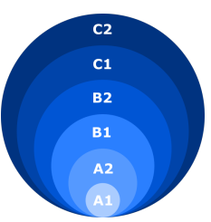
Tour de Table - Transposition of the European Accessibility Act in German Law
Additional accessibility requirements related to specific services (Annex I, section IV EAA)
(e) Consumer banking services:
(i) providing identification methods, electronic signatures, security, and payment services which are perceivable, operable, understandable and robust;
(ii) ensuring that the information is understandable, without exceeding a level of complexity superior
to level B2 (upper intermediate) of the Council
of Europe’s Common European Framework
of Reference for Languages (CEFR).

Slide 5
Tour de Table - Transposition of the European Accessibility Act in German Law
European Accessibility Act
(Art. 31)
National laws have to be
adopted and published until 28 June 2022,
applied beginning from 28 June 2025
Transposition in Germany
by two regulations, coming into force on 28 June 2025
Barrierefreiheitsstärkungsgesetz (BFSG), announced in July 2021
Draft of Verordnung zum BFSG (BFSGV), purposed in February 2022, will probably pass the German Bundesrat on 20 May 2022
© European Federation of Building Societies

Slide 6
Tour de Table - Transposition of the European Accessibility Act in German Law
Draft of German regulation (Draft of the BFSGV):
Relevance of Level B2 CEFR for precontractual and contractual information about credit agreements under CCD oder MCD?
NO need for translation to LEVEL B2
LEVEL B2 ONLY necessary for
SECCI
ESIS
Adequate explanations on significant information about the credit agreement
General Terms of Conditions

Slide 7
Tour de Table
Short oral reports of the Committee members
on current legal developments

