Slide 1
EFBS spring meeting 2022
General Assembly 12 May 2022, 4:00pm–5:00pm, Thon Hotel EU Brussels

Slide 2
EFBS General Assembly – Agenda
1. Secretary/ Additions to the Agenda
2. Quorum (Approval of minutes EFBS: autumn meeting 2021 in Berlin)
3. Virtual Keynote: MEP Dr. Othmar Karas, First Vice-President of the European Parliament and Shadow Rapporteur for EPP on Basel
4. Presentation by Ms Julia Braun on “Stabilising effects of the bauspar business on housing market cycles”, PhD student at University of Hohenheim
5. Election of Ms Bernadett Tátrai, CEO Fundamenta-Lakáskassza Zrt. as EFBS president
6. Outlook on the Federation's activities in 2022 by the Managing Director
7. Annual Financial Statement 2021
8. Release of the Managing Director
9. Date and location for the EFBS autumn meeting 2022

Slide 3
EFBS General Assembly – Agenda
1. Secretary/ Additions to the Agenda
2. Quorum (Approval of minutes EFBS: autumn meeting 2021 in Berlin)
3. Virtual Keynote: MEP Dr. Othmar Karas, First Vice-President of the European Parliament and Shadow Rapporteur for EPP on Basel
4. Presentation by Ms Julia Braun on “Stabilising effects of the bauspar business on housing market cycles”, PhD student at University of Hohenheim
5. Election of Ms Bernadett Tátrai, CEO Fundamenta-Lakáskassza Zrt. as EFBS president
6. Outlook on the Federation's activities in 2022 by the Managing Director
7. Annual Financial Statement 2021
8. Release of the Managing Director
9. Date and location for the EFBS autumn meeting 2022

Slide 4
Election of the new EFBS president
Since January 2017, Chairwoman of the Board and CEO at Fundamenta
Joined the Management of Fundamenta in 2016
Previously served as the Head of Retail & Deputy CEO at UniCredit Bank Hungary for 9 years
Responsible for managing the Retail Division as a Member of the Board at ERSTE Bank Hungary
History in financial services industry, with wide-ranging experience in management, retail business, private banking and business strategy

Slide 5
EFBS General Assembly – Agenda
1. Secretary/ Additions to the Agenda
2. Quorum (Approval of minutes EFBS: autumn meeting 2021 in Berlin)
3. Virtual Keynote: MEP Dr. Othmar Karas, First Vice-President of the European Parliament and Shadow Rapporteur for EPP on Basel
4. Presentation by Ms Julia Braun on “Stabilising effects of the bauspar business on housing market cycles”, PhD student at University of Hohenheim
5. Election of Ms Bernadett Tátrai, CEO Fundamenta-Lakáskassza Zrt. as EFBS president
6. Outlook on the Federation's activities in 2022 by the Managing Director
7. Annual Financial Statement 2021
8. Release of the Managing Director
9. Date and location for the EFBS autumn meeting 2022

Slide 6
Outlook on the Federation's activities in 2022
Report by Christian König
Managing Director of the EFBS

Slide 7
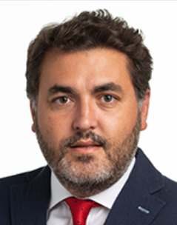
Meetings on Basel with MEPs
EFBS met on 9 February 2022 the S&D rapporteur on the final Basel III agreement, Jonás Fernández
MEP Fernández will also be the author of an article in the next EFBS annual report
During bilateral exchange, EFBS raised its concerns and provided written amendments
EFBS agreed with MEP Fernández to stay in close contact on relevant topics

Slide 8
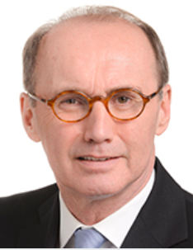
Meetings on Basel with MEPs
EFBS met on 18 March 2022 the office of EPP shadow rapporteur on the final Basel III agreement, Othmar Karas
For MEP Karas the Output Floor proposal is a package solution – transitional periods for Residential Real Estate are a must
Office of MEP Karas was grateful for EFBS input on the calculation of the services component (OpRisk)

Slide 9
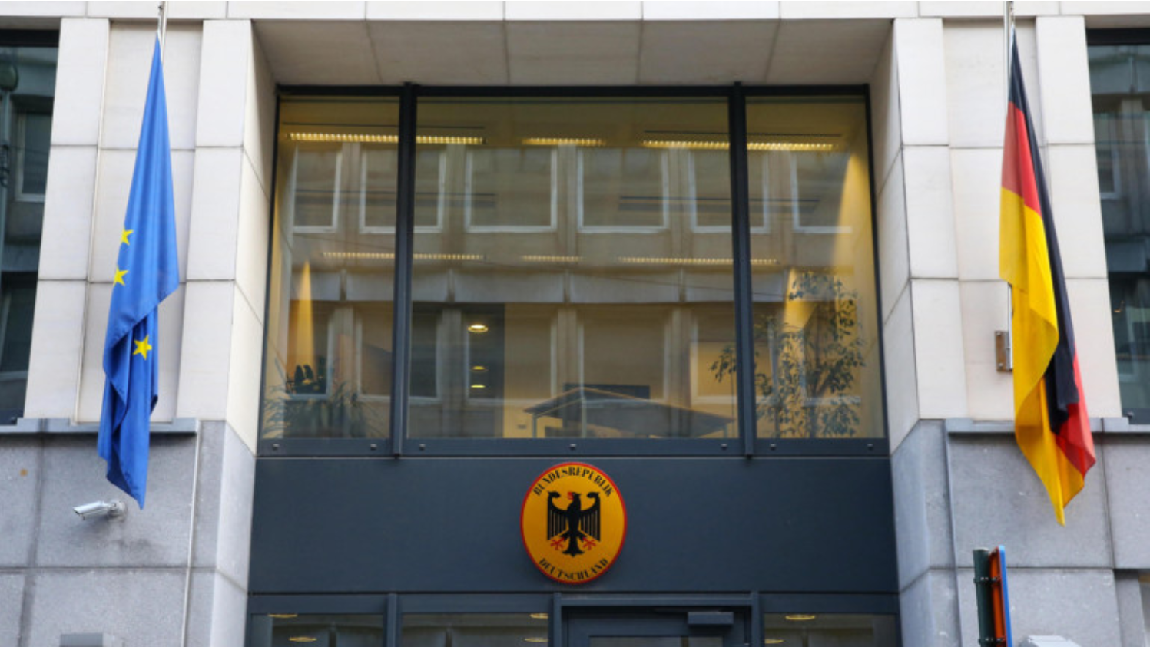
Meetings on Basel with Permanent Rep.
EFBS met on 25 March 2022 representatives of the German Permanent Representation in Brussels (Ms Marie Gold) and of the German Ministry of Finance (Mr Paul Beck)
EFBS drafts on OpRisk (services component) have been discussed
German Ministry of Finance gave insights in their position on the Output Floor
Agreed on follow-up discussions

Slide 10
Meetings on Basel with Permanent Rep.
EFBS met on 11 March 2022 the Slovenian financial attaché responsible for the Basel III file, Mr Ales Bradač
Mr Bradač gave insights on further loan level criteria such as LTV/ Income to value that his government might ask for to be supportive of the transitional period residential real estate when calculating the output floor

Slide 11
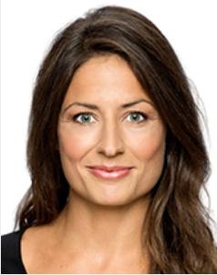
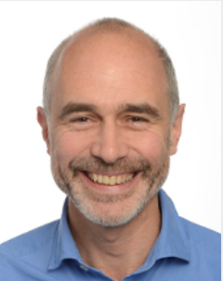
Meetings on Basel
EFBS will follow up with all representatives mentioned so far
EFBS is scheduling further exchanges with responsible financial attaches of Austria (Mr Maximilian Flesch), the Czech Republic (Mr Martin Blažek) and Sweden.
In addition, the EFBS would also address the ECON MEPs Gilles Boyer (Renew Europe) and Linea Sogaard-Lidell (Renew Europe)

Slide 12
Meetings on green finance with COM
EFBS met on 1 April 2022 with staff of the European Commission’s department for Sustainable Finance (FISMA.B.2), i.a. Mr Andreas Rajchl
Exchange of views on a variety of green finance topics such as
Greening the MCD
Green Mortgages
Green Supporting Factor
Extension of Taxonomy regulation

Slide 13
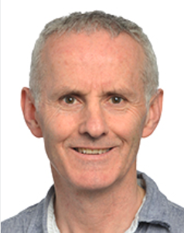
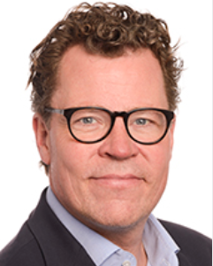
Meetings on EPBD with MEPs
EFBS will reach out to Members of European Parliament to discuss the revision of the Energy Performance of Buildings Directive (EPBD)
Meetings foreseen i.a. with Green rapporteur Ciaran Cuffe, Renew shadow-rap. Morten Petersen and EVP shadow rapporteur Seán Kelly
EFBS welcomes the approach to improve the provisions on energy performance certificates (set out in Art. 16 to 19)

Slide 14
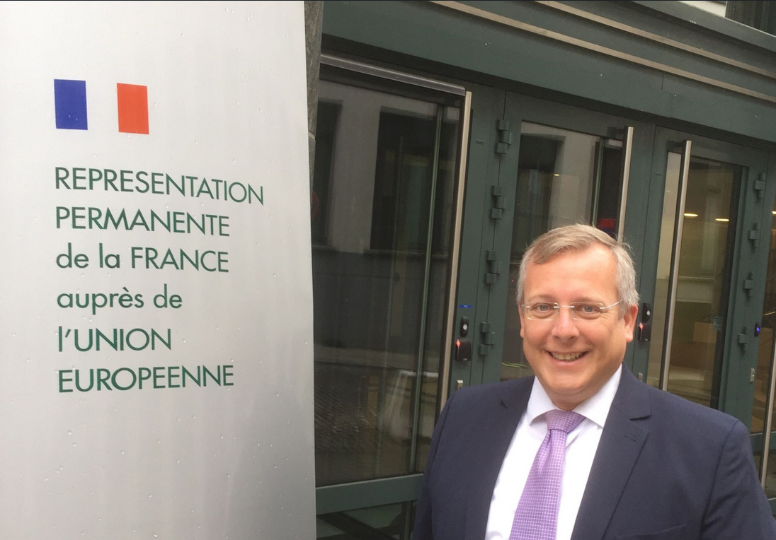
Meetings with Permanent Representation on CCD
EFBS consulted on the issue relevant to Bausparkassen on how the rules on responsible lending/borrowing (e.g., pre-contractual information, caps on interests/costs and creditworthiness assessment) can be improved under the new CCD proposal.
The French Presidency is working on a “general approach” until early June 2022.
Outlook: The French representatives wanted to simplify the information requirements proposed by the Commission and adapt the new strict requirements for creditworthiness assessments. At least, however, the compromise reached in the Council seems to have been successful, for example, in limiting the right of withdrawal (1 year and 14 days) and the (cost/interest) ceilings at EU level (current wording: "Member States shall introduce measures to ensure that creditors do not charge excessively high interest rates, annual percentage rates of charge on loans or total costs of credit").

Slide 15
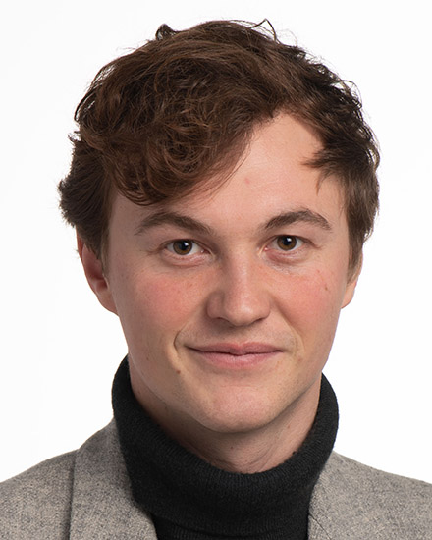
Meetings on CCD with MEPs
EFBS met and sent amendments to the rapporteur and the so-called shadow rapporteurs responsible for the CCD
On 28 March 2022, the IMCO Committee held its first public exchange of views on 808 tabled amendments
The shadow rapporteur from the Greens from Germany will report on the current state of negotiations in the IMCO Committee in the Legal Affairs Committee tomorrow

Slide 16
Outlook on the Mortgage Credit Directive (MCD) - PAST -
Retail financial services - FISMA.B.3 = the European Commission’s department responsible for the MCD
Study: assessed via a study conducted by an external consulting firm the functioning of the MCD according to Article 44 and 45
EFBS was consulted and gave feedback
The results of the study and DG FISMA’s report on this study confirmed that
Provisions of the MCD are still relevant
No legislative changes are necessarily needed
Several challenges hinder the functioning of the MCD

Slide 17
Outlook on the MCD - FUTURE -
This spring: DG FISMA decided to investigate these challenges further and collect new evidence in the next months
Public consultation
Call for evidence
Public consultation
Approx. 60 questions you provided us input on & we forwarded to DG FISMA on 28 February
Call for evidence
Specific questions addresses to EBA (e.g., on foreign currency loan, impact of digitalisation, information disclosure rules (at pre-contractual and in advertising stages), creditworthiness assessment, robo-advice, ways to facilitate cross-border provision for mortgages, financial stability, lessons from COVID and green mortgages)
Content of EBA’s opinion will be based exclusively on feedback from national supervisors
Opinion is due until end of June
EFBS exchange with DG FISMA
Tomorrow: DG FISMA will report on their work and discuss possible adjustments in the legal affairs committee

Slide 18
EFBS General Assembly – Agenda
1. Secretary/ Additions to the Agenda
2. Quorum (Approval of minutes EFBS: autumn meeting 2021 in Berlin)
3. Virtual Keynote: MEP Dr. Othmar Karas, First Vice-President of the European Parliament and Shadow Rapporteur for EPP on Basel
4. Presentation by Ms Julia Braun on “Stabilising effects of the bauspar business on housing market cycles”, PhD student at University of Hohenheim
5. Election of Ms Bernadett Tátrai, CEO Fundamenta-Lakáskassza Zrt. as EFBS president
6. Outlook on the Federation's activities in 2022 by the Managing Director
7. Annual Financial Statement 2021
8. Release of the Managing Director
9. Date and location for the EFBS autumn meeting 2022

Slide 19
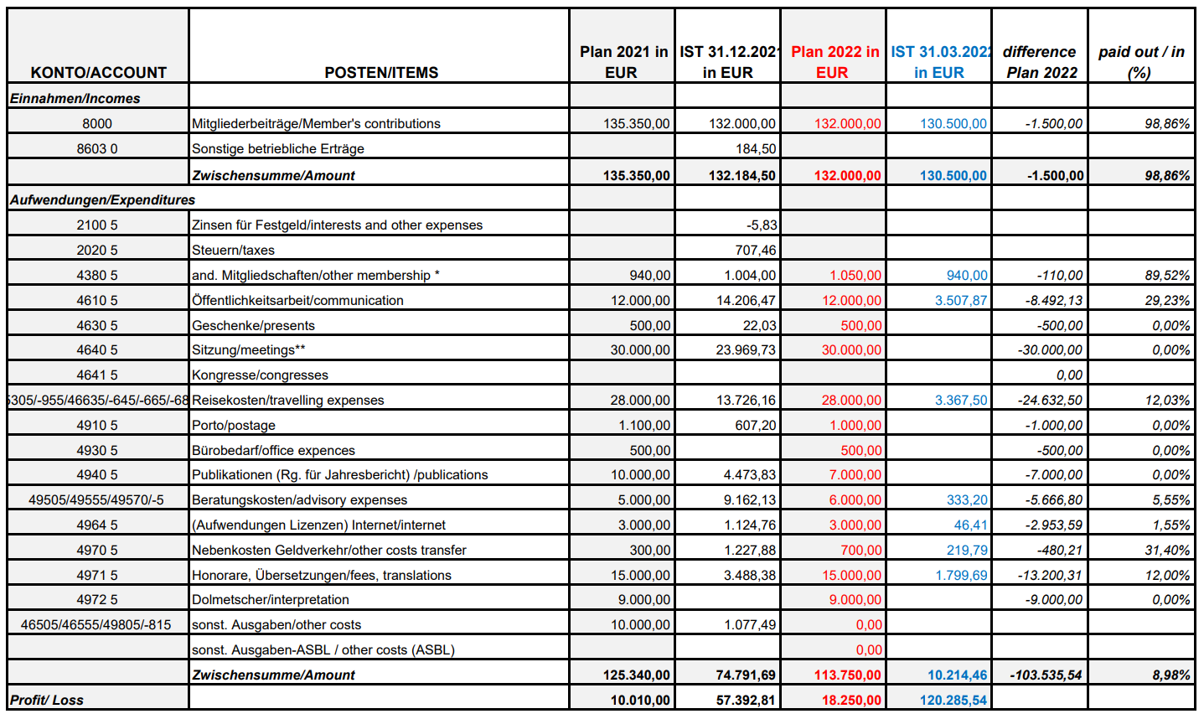
EFBS Annual Financial Statement 2021

Slide 20
EFBS General Assembly – Agenda
1. Secretary/ Additions to the Agenda
2. Quorum (Approval of minutes EFBS: autumn meeting 2021 in Berlin)
3. Virtual Keynote: MEP Dr. Othmar Karas, First Vice-President of the European Parliament and Shadow Rapporteur for EPP on Basel
4. Presentation by Ms Julia Braun on “Stabilising effects of the bauspar business on housing market cycles”, PhD student at University of Hohenheim
5. Election of Ms Bernadett Tátrai, CEO Fundamenta-Lakáskassza as EFBS president
6. Outlook on the Federation's activities in 2022 by the Managing Director
7. Annual Financial Statement 2021
8. Release of the Managing Director
9. Date and location for the EFBS autumn meeting 2022

Slide 21
Next EFBS meeting 2022
Luxembourg
13 October 2022 (afternoon)
14 October 2022 (morning)

