Slide 1
Tour de Table - Current Court Decisions in Germany
Legal Affairs Committee
Thursday, 7 October 2021,
Agnes Freise

Slide 2
Tour de Table - Current Court Decisions in Germany
Amendment of general terms and conditions of a bank by deemed consent of the consumer in the event of lack of his timely rejection
Annual Fees during the Saving Period of a Bauspar Contract

Slide 3
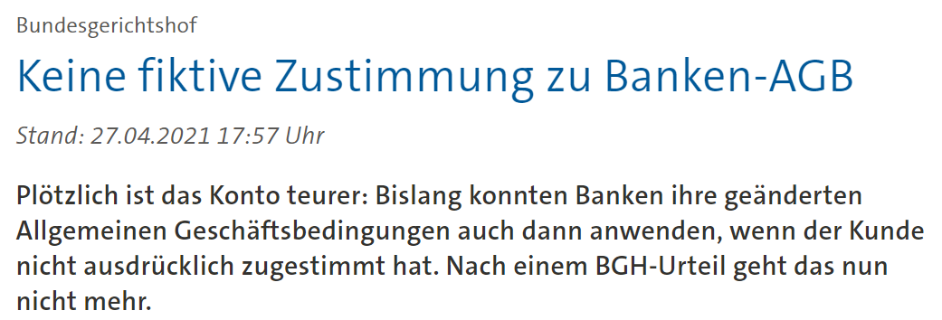
Amendment of the GTC by deemed consent
Federal Court of Justice, Judgement of 27 April 2021, XI ZR 26/20:
No effectiveness of provisions regarding the deemed consent of the consumer to amendments in the general terms and conditions

Slide 4
Amendment of the GTC by deemed consent
Federal Court of Justice, Judgement of 27 April 2021, XI ZR 26/20
No effectiveness of 2 provisions regarding the deemed consent of the consumer to amendments of the general terms and conditions of a bank:
Amendments of general terms and conditions and the special conditions without any restriction, No. 1 (2) GTC
Amendments of charges for services which are typically used by the customer, No. 12 (5) GTC
Common content of these 2 provisions:
Amendments shall be offered to the customer in text form no later than 2 months before their proposed entry into force.
The customer shall be deemed to have given his consent unless he has notified the bank of his refusal before the proposed date of entry into force.
The bank shall specifically inform the consumer in its proposal that such consent will be assumed in the absence of any objection.
If amendments of the charges are proposed to the consumer, he may terminate the contract before the date of their entry into force free of charge.

Slide 5
Amendment of the GTC by deemed consent
Federal Court of Justice, Judgement of 27 April 2021, XI ZR 26/20
Reaction of the German Banks:
NEW No.1 (2) GTS: Very restricted possibility of amendments by deemed consent
NEW No. 12(5) GTS: No possibility to introduce or to amend any charges by deemed consent
Reaction of the German Bausparkassen:
No need for amendments of the Sample Bauspar Terms and Conditions :
Very restricted possibility of amendments by deemed consent of the consumer
Possibility to amend the bauspar terms and conditions by:
Consent of the Federal Financial Supervisory Authority, or
Deemed consent of the consumer,
mostly if the amendment is needed in order to comply with
legal provisions or regulations issued after the conclusion of the Bauspar contract, or
decisions of the Federal Court of Justice issued after the conclusion of the Bauspar contract

Slide 6
Annual Fees during the Saving Period
No Loan Fee
Saving period
Loan period
Annual Fees?
No annual fees
Closing Fee
Decisions of the Federal Court of Justice with regard to Bauspar Fees
2010: Effectiveness of Closing Fee
2016: Ineffectiveness of Loan Fee
2017: Ineffectiveness of annual fees during loan period
2022: Effectiveness of annual fees during saving period??

Slide 7
Tour de Table
Short oral reports of the Committee members
on current legal developments

