Slide 1
Incorporation of ESG into the risk management of credit institutions
Max Lesemann, VdPB
19 March 2021

Slide 2
Agenda
EBA discussion paper on the incorporation of ESG into the risk management of credit institutions
EBA opinion on the key performance indicators for non-financial reporting & a green asset ratio
EBA consultation paper regarding ITS on disclosure requirements of the CRR (for SIs)

Slide 3
ESG disclosure requirements in the EU
TAXONOMY
DISCLOSURES
NON-FINANCIAL
STATEMENT
(NFRD)
EBA PRUDENTIAL DISCLOSURES
(CRR)
DISCLOSURE REGULATION
(SFDR)
Defines environmentally sustainable activities
Corporates´ ESG and diversity information
ESG risks and risk mitigating actions
Investment products and financial advice
NFRD corporates*
Public-interest companies with more than 500 employees
Large listed banks (CRR) and investment firms (IFR)
Financial firms selling investment products and financial advisers

Slide 4
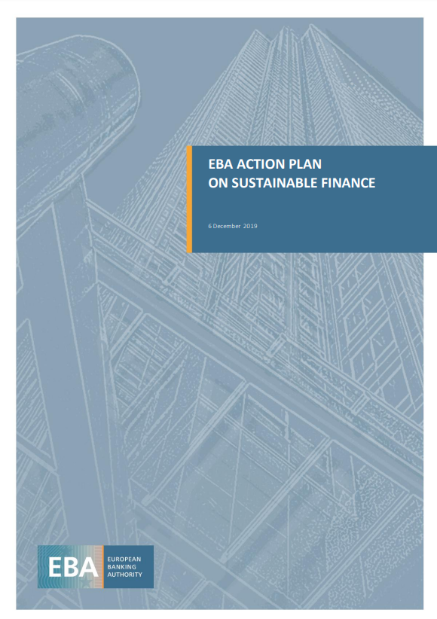
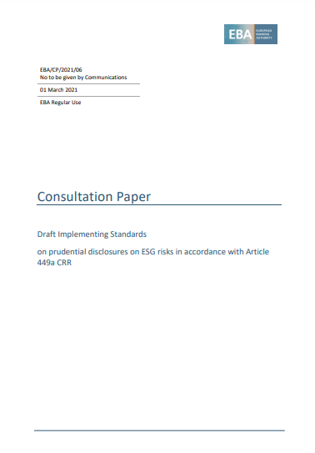
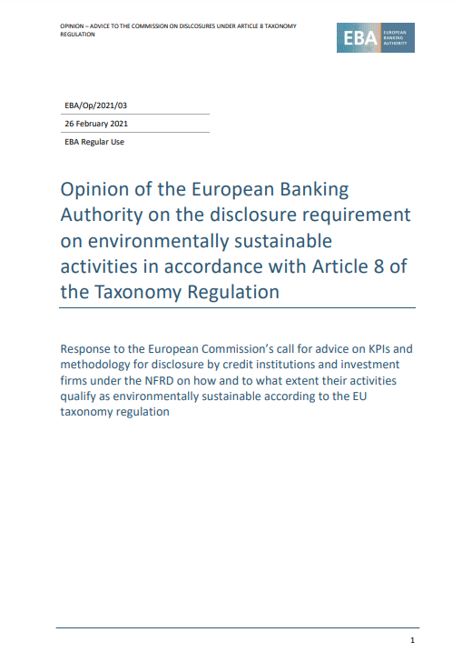
Background
EBA`s action plan on sustainable finance shows deliverables and activities related to environmental, social and governance (ESG) factors and risks
?
?
We are facing a wave of regulations by several authorities

Slide 5
Discussion paper on ESG risks management and supervision
Common definitions
ESG factors
Indicators, metrics and methods to evaluate ESG risks
E, S and G indicators and metrics
ESG risks management
Business strategy and business processes
ESG risks supervision
ESG factors as drivers of financial risks
ESG risks
Tools and methods to evaluate, estimate and incorporate ESG risks
Governance and risk management
Policy recommendations
Transmission channels (physical, transition and liability risks)
Extension of time horizon in supervisory assessment (via scenario analysis/stress test)
Policy recommendations

Slide 6
Discussion paper on ESG risks management and supervision
Published 3 November 2020, consultation open till 3 February 2021
EFBS feedback focused on the specificities of the retail business:
the nature of retail business rather points to a product rather than a client-based approach and will heavily depend on availability and standardization of suitable data.
key driver in retail should be around private housing and mortgages apart from private investments and to a lesser extent consumption

Slide 7
KPIs and Green Asset Ratio
1 March 2021: Opinion by EBA in response to the Commission’s call for advice on KPIs and related methodology (scope and methodology ) for the disclosure by credit institutions.
GAR: identifies the institutions’ assets financing activities that are environmentally sustainable according to the EU taxonomy, that can be used to identify whether banks are financing sustainable activities.
Mortgages and renovation loans are included in the GAR (Taxonomy criteria are to be applied).

Slide 8
ITS on disclosure requirements of the CRR
Consultation paper published on 1 March 2021- feedback open until June 2021
DP on i.a. comparable quantitative disclosures on climate-change related transition and physical risks, including information on exposures towards carbon related assets and assets subject to chronic and acute climate change events.
The ITS include qualitative information on how institutions are embedding ESG considerations in their governance, business model and strategy and risk management framework

Slide 9
Timeline
Final EBA paper on ESG risks management and supervision to be published in June 2021
Commission set to adopt KPIs and GAR by June 2021
Consultation on ITS closes on 1 June 2021
There is sufficient time for Bausparkassen to gather input and provide the EBA with concrete feedback.

