Slide 1

EuBV – Spring meeting 19.03.2021
EuBV - finance committee 19.03.2021

Slide 2
4. Dealing with nonperforming loans in the COVID 19 pandemic
European Commission Action Plan
Strategy to prevent a future build-up of NPLs across the EU, as a result of the coronavirus crisis
EC is proposing a series of actions with four main goals:
  further develop secondary markets for distressed assets, which will allow banks to move NPLs off their balance sheets, while ensuring further strengthened protection for debtors
  reform the EU’s corporate insolvency and debt recovery legislation, which will help converge the various insolvency frameworks across the EU, while maintaining high standards of consumer protection
  support the establishment and cooperation of national asset management companies (AMCs) at EU level
  implement precautionary public support measures, where needed, to ensure the continued funding of the real economy under the EU’s Bank Recovery and Resolution Directive and State aid frameworks
Source: EC Press release, IP/20/2375, 16 December 2020

Slide 3
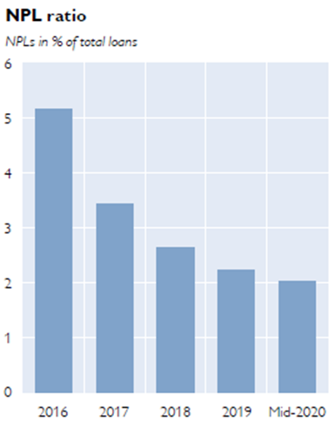
4. Dealing with nonperforming loans in the COVID 19 pandemic
Non performing loans in Austria According to the OeNB Financial Stability Report 40, November 2020: Payment moratoria as well as fiscal and monetary measures supported a further improvement of loan quality ratios in the first half of 2020 The consolidated NPL ratio of the Austrian banking sector came down to 2.0%, nearly 20 basis points lower than at end-2019. For the domestic loan book, the NPL ratio improved to 1.5%. Share of loans assigned to stage 2 according to IFRS 9 increased markedly, from 10% at end-2019 to 16% in June 2020. For corporate loans, this share even increased from 10% to 22%. Consequently, Austrian banks increased their loan loss provisioning to EUR 1.8 billion, after only EUR 1.0 billion for the entire year of 2019. The consolidated coverage ratio rose by 74 basis points to nearly 50%. Recommendations by the OeNB regarding NPLs: Prepare for the time when public support measures in Austria and in CESEE expire and ensure transparency regarding the credit quality of loan portfolios. Apply sustainable lending standards in real estate lending, both in Austria and in CESEE, and comply with the quantitative guidance issued by the Financial Market Stability Board.
Source: OeNB Financial Stability Report 40, Nov 2020

Slide 4
5. Use of payment moratoria in response to the COVID 19 pandemic
First evidence on the use of moratoria and public guarantees in the EU banking sector, EBA/Rep/2020/31
EBAs first assessment of the use of COVID-19 moratoria and public guarantees across the EU banking sector as of end June 2020 as reported by a sample of ca. 130 banks.
A nominal loan volume of EUR 871 billion was granted moratoria on loan repayments, comprising about 6% of banks’ total loans and close to 7.5% of total loans to households (HHs) and NFCs. In total, 16% of SME loans were granted moratoria, followed by 12% of commercial real estate (CRE) loans and 7% of residential mortgage loans.
While the NPL ratio for loans subject to moratoria was 2.5% (slightly lower than the EU average of 2.9% for all loans), around 17% of loans under moratoria were classified as stage 2.
Newly originated loans subject to PGSs amounted to EUR 181 billion, representing 1.2% of the total loans.
Source: EBA Press release, 20 November 2020

Slide 5
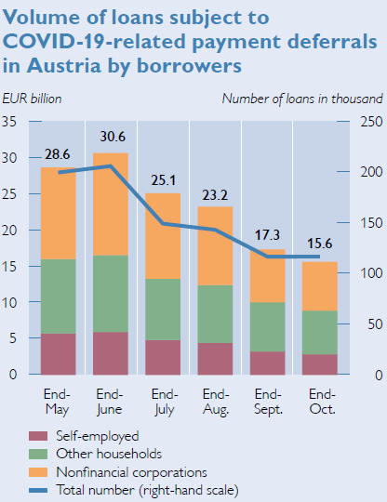
5. Use of payment moratoria in response to the COVID 19 pandemic
Austrian measures to support the economy during the pandemic Legislative moratorium on credit and interest payments due between 1 April 2020, and 31 January 2021 offers household or micro-business borrowers suffering from COVID-19-related income losses the option to defer payments for a period of ten months and to extend loan tenors by the duration of the moratorium. Sector-wide nonlegislative moratorium, including (retrospective) deferrals in the period from 15 March 2020 to 31 August 2020. In addition, banks and their customers agreed bilaterally on voluntary individual forbearance measures. COVID-19-related public guarantee scheme for newly originated loans: Eligible nonfinancial corporations can use guarantees to obtain bridge financing. By end-June 2020, Austrian banks had granted COVID-19-related payment extensions (including payment modifications from other countries) in the amount of EUR 46 billion (4.5% of total outstanding credit to households and nonfinancial corporations or 1.6% of unconsolidated total assets on a consolidated level), around 20,200 loans subject to COVID-19-related public guarantees totaling EUR 6 billion had been requested in Austria. Source: OeNB Financial Stability Report 40, November 2020
Source: OeNB Financial Stability Report 40, Nov 2020

Slide 6
Macro figures Austria
Austria real GDP & unemployment
Source: WIFO Konjunkturprognose Dezember 2020
NPL ratio Austrian financial intermediaries
Source: OeNB Financial Stability Report 40, Nov 2020
Source: OeNB Financial Stability Report 40, Nov 2020
Source: OeNB Financial Stability Report 40, Nov 2020
Risk provisioning Austrian financial intermediaries
Coverage ratio Austrian financial intermediaries

Slide 7

BAUSPARKASSEN – WICHTIGER DENN JE

