Slide 1
Implementation of ECJ’s Lexitor judgement (C-383/18)
Legal Affairs Committee
Friday, 19 March 2021
Agnes Freise

Slide 2
ECJ’s Lexitor judgement (C-383/18)
Consumer Credit Agreement
Commission
for granting the credit,
paid by the consumer
Early repayment
of the credit
by the consumer
Does the consumers’ right to a reduction of the total cost of a credit include those costs which are independent of the duration of the credit agreement?

Slide 3
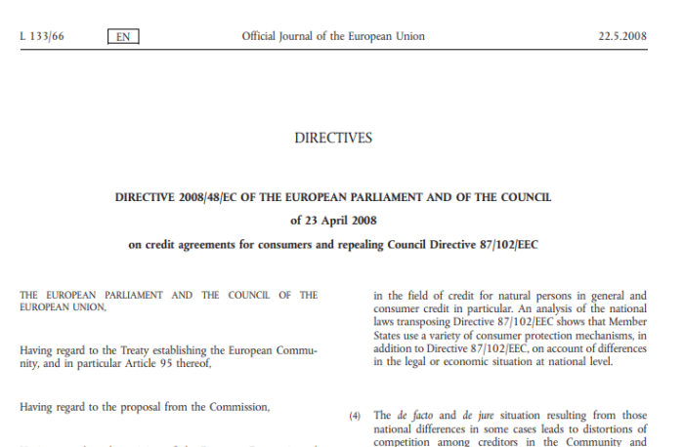
ECJ’s Lexitor judgement (C-383/18)
Consumer Credit Directive 2008/48 (CCD)
Article 16: Early Repayment
1. The consumer shall be entitled at any time to discharge fully or partially his obligations under a credit agreement. In such cases, he shall be entitled to a reduction in the total cost of the credit, such reduction consisting of the interest and the costs for the remaining duration of the contract.
2. In the event of early repayment of credit the creditor shall be entitled to fair and objectively justified compensation for possible costs directly linked to early repayment of credit provided that the early repayment falls within a period for which the borrowing rate is fixed.

Slide 4
ECJ’s Lexitor judgement (C-383/18)
CCD
Article 3: Definitions
(g) total cost of the credit to the consumer means all the costs, including interest, commissions, taxes and any other kind of fees which the consumer is required to pay in connection with the credit agreement and which are known to the creditor, except for notarial costs; costs in respect of ancillary services relating to the credit agreement, in particular insurance premiums, are also included if, in addition, the conclusion of a service contract is compulsory in order to obtain the credit or to obtain it on the terms and conditions marketed.

Slide 5
ECJ’s Lexitor judgement (C-383/18)
Opinion of Advocate General Hogan,
23 May 2019:
“As will shortly be demonstrated, the meaning of this legislative provision […] is, in some respects at least, obscure and does not easily lend itself to an interpretation which is satisfactory. It may indeed be — possibly by reason of the issues thrown up by this very reference — that the Union legislature might wish at some point to re-visit the wording of this provision.”

Slide 6
ECJ’s Lexitor judgement (C-383/18)
ECJ, Reasoning of the Judgement, 11 September 2019:
Limiting the reduction of the total cost of the credit to those costs presented by the creditor as dependent on the duration of the contract would reduce the effectiveness of the right of the consumer to a reduction in the total cost of the credit. It would entail the risk that the consumer would be required to make a higher one-off payment when concluding the credit agreement since the creditor could be tempted to reduce the costs depending on the duration of the contract to a minimum.
Including costs which are not dependent on the duration of the contract in the reduction is not likely to be disproportionately disadvantageous to the creditor. In the event of early repayment, the creditor is recovering the sum borrowed ahead of schedule, which is then available for the conclusion of new credit agreements. The interests of the creditor are taken into account also by means of Article 16 (2) CCD, which provides for the right to compensation for costs directly linked to early repayment of the contract.

Slide 7
ECJ’s Lexitor judgement (C-383/18)
JUDGEMENT OF THE ECJ
11 September 2019
“the answer to the question referred for a preliminary ruling is that Article 16(1) of Directive 2008/48 must be interpreted as meaning that the right of the consumer to a reduction in the total cost of the credit in the event of early repayment of the credit includes all the costs imposed on the consumer”

Slide 8
Closing Fee – German Bauspar Contract
Bauspar Savings
(e.g. 40.000 €)
Bauspar Contract
Bauspar Sum (e.g. 100.000 €)
Anticipatory Loan
(e.g. 100.000 €)
Bauspar Loan
(e.g. 60.000 €)
Closing Fee
(e.g. 1.000 €)
A part of the closing fee for the Bauspar contract
is included in the total cost of the Bauspar loan
and may be also included in the total cost of an anticipatory loan.

Slide 9
Implementation of ECJ’s Lexitor judgement in Germany (§ 501 BGB)
Current Legislation | Draft Legislation
Insofar as the borrower fulfils his obligations prematurely or the remaining debt becomes due by termination before the agreed time, the total cost of the credit shall be reduced by the interest and other term-related costs. | (1) Insofar as the borrower fulfils his obligations under a consumer loan agreement prematurely, the total cost of the credit shall be reduced by the interest and the costs. (2) Insofar as the residual debt of a consumer loan becomes due by termination before the agreed time, the total cost of the credit shall be reduced by the interest and the other term-related costs.
Soweit der Darlehensnehmer seine Verbindlichkeiten vorzeitig erfüllt oder die Restschuld vor der vereinbarten Zeit durch Kündigung fällig wird, vermindern sich die Gesamtkosten um die Zinsen und sonstigen laufzeitabhängigen Kosten. | (1) Soweit der Darlehensnehmer seine Verbindlichkeiten aus einem Verbraucherdarlehensvertrag vorzeitig erfüllt, ermäßigen sich die Gesamtkosten des Kredits um die Zinsen und die Kosten. (2) Soweit die Restschuld eines Verbraucherdarlehens vor der vereinbarten Zeit durch Kündigung fällig wird, ermäßigen sich die Gesamtkosten des Kredits um die Zinsen und die sonstigen laufzeitabhängigen Kosten.

Slide 10
Implementation of ECJ’s Lexitor judgement in Germany (§ 501 BGB)
Draft Legislation
(1) Insofar as the borrower fulfils his obligations under a consumer loan agreement prematurely, the total cost of the loan shall be reduced by the interest and the costs.
Only early repayment, not early termination of a contract Both consumer credits and mortgage credits Reduction of costs does not only include costs which are dependent on the duration of the contract Reduction of all costs which are included in the total cost of a credit as defined in Art 3 (g) CCD? Third-party costs (i.e. fees for an insurance contract paid to an insurance company, fees for registering a mortgage paid to the registry office)? Costs paid to the creditor not for the credit agreement itself (i.e. costs for a saving contract or a bauspar contract)?

Slide 11
Implementation of ECJ’s Lexitor judgement in Germany (§ 501 BGB)
Draft Legislation - Explanatory memorandum
The amendment of section 501(1) of the German Civil Code is intended to implement the ECJ ruling of 11 September 2019, C-383/18. In view of the full harmonisation of the directive, no regulation going beyond or falling short of this is to be made. The wording of Section 501(1) of the German Civil Code is therefore closely aligned with the wording of the Directive. This makes it possible, if necessary, to take into account future clarifications by the ECJ on the scope of the right of reduction in Article 16(1) of the Directive. This concerns in particular the question of whether the right of reduction extends to all total costs of the credit within the meaning of Article 3(g) of the Directive; i.e. also to third-party costs, or only to those costs that are relevant in the contractual relationship between the lender and the borrower (for which parts of the reasoning of the judgement speak).

Slide 12
Tour de Table
Short oral reports by the committee members
on the practical experiences
with regards to the problems in implementing the CCD in their respective countries
(e.g., implementation of ECJ’s Lexitor judgement)

