Slide 1
Czech Economic Outlook
European Congress
of the European Federation of Building Sociaties
Tomáš Nidetzký
Deputy Governor
Czech National Bank
Prague
October 17, 2019

Slide 2
Flexible Inflation Targeting

Slide 3
Banks Dominate Financial Market
asset/GDP ratio is slightly over 150%
24 banks and 25 foreign branches
(EU, US, Japan, China)
Czech private banks represent just 7% of the banking sector assets
bank assets amount to CZK 7.200 bn (EUR 300 bn)

Slide 4
Banking Sector Performance
Well capitalized: capital ratio = 20%
Ample liquidity: L/D ratio = 74%
Growing loans: growth y/y = 7.2%
Highly profitable: ROE = 18%
ROA = 1.1%
Risks under control: NPL = 3.2%
coverage ratio = 68%
*end of 2018

Slide 5
Czech Republic is a Small …
Source: IMF

Slide 6
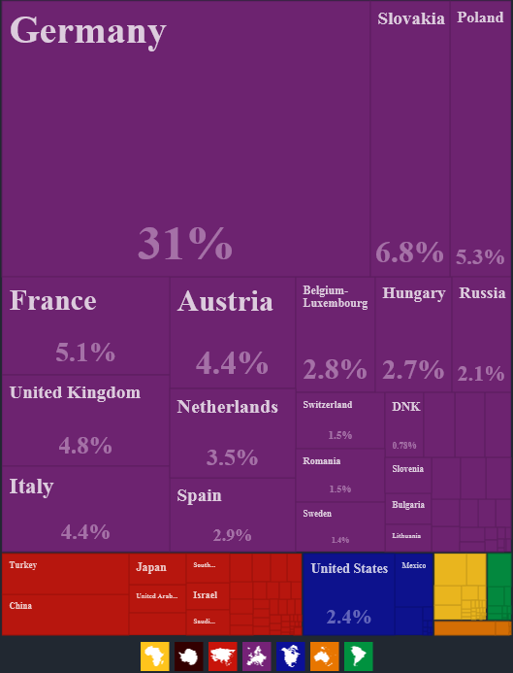
… and Open Economy
exports/GDP:
- Czech Republic 80%
- World 30%
- EU 45%
top destination:
- Germany 31%
- Slovakia 7%
- Poland 5%
vehicles and machinery dominate
pros: presence in global supply chains, emphasis on technological progress
cons: influence of foreign demand
Source: Economic Complexity Observatory, MIT Media Lab

Slide 7
Euro Area Outlook
economic slowdown with downside risks
effective euro area outlook: +1.1% in 2019, +1.3% in 2020
risks and uncertainties: trade wars, Brexit, geopolitics
direct and indirect impacts through re-exports
Germany under pressure

Slide 8
Germany Under Pressure
GDP slowdown and down side risks
PMI in manufacturing lowest since 2009
new orders in manufacturing in August -6.7% y-o-y
leading indicators interpreted as recession by analysts

Slide 9
Euro Area PPI Development
PPI expected to fall to 0.4% by the end of 2019
euro area PPI influence Czech import costs and export competitiveness
consumer inflation in effective euro area 1%-1.5% in 2019 and 2020
does ECB have enough ammunition to reach its target…

Slide 10
Low For Long Scenario
further easing of monetary conditions: - deposit rate to -0.5% - restart of the asset purchase program at a monthly pace of EUR 20 billion as from November
whole Germany government bonds yield curve below zero
transmission of EA rates to Czech rates subdued
Czech monetary policy autonomy

Slide 11
Solid Economic Growth
external slowdown was not very visible in the domestic economy
continued robust growth in household consumption
private and government investments are crucial
economic data signal continued solid economic growth

Slide 12
Overheated Labour Market
unemployment at record lows and stabilized
persisting strong demand for labour
wage growth will remain high

Slide 13
Flexible Inflation Targeting
inflation to stay above the 2% target but still within the tolerance band
faster growth in food prices and smaller decline in fuel prices
driven also by growth in imputed rents and other housing-related prices
weaker than forecasted CZK leads to higher price pressures from imports

Slide 14
Exchange Rate Development
exchange rate is not targeted
CNB doesn’t influence exchange rate since April 2017
CZK may be overbought, but HUF/EUR and PLN/EUR develop similarly
important for the overall monetary conditions

Slide 15
Interest Rates Unchanged
slightly inflationary overall balance of risks to the forecast
uncertainty regarding the impacts of protectionism and Brexit remains
preference for leaving rates unchanged ultimately prevailed

Slide 16
Executive Summary
Czech Republic is a small and open economy with presence in global supply chains
solid economic growth, external slowdown was not very visible in the domestic economy
inflation to stay above the 2% target but still within the tolerance band
foreign demand waning, re-exports under pressure of global risks and uncertainties
subdued transmission of euro area slowdown creates space for relative monetary policy autonomy

Slide 17
Worth reading:
  Inflation report
  Financial stability report
  Global economic outlook
More information available at www.cnb.cz
Thank you for your attention.

