Slide 1
EDIS
EFBS Legal Affairs Committee
16 October 2019, Prague
Jonathan Pfenning

Slide 2
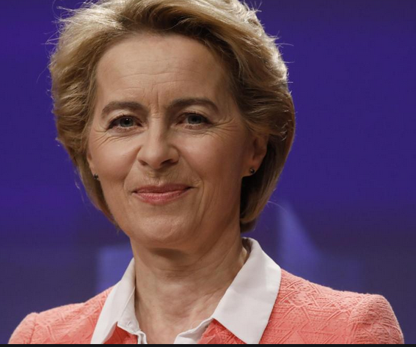
EDIS - State of Play
“To ensure people have peace of mind when it comes to the safety of their bank deposits, we need a European Deposit Insurance Scheme (EDIS).”
Political Guidelines for the next European Commission 2019-2024
"A Union that strives for more - My agenda for Europe",
By candidate for President of the European Commission
Ursula von der Leyen (Summer 2019)

Slide 3
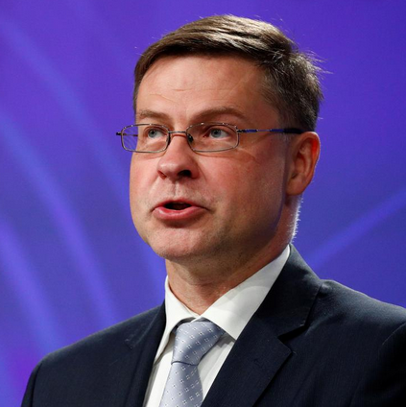
EDIS - State of Play
“Completing the Banking Union will be a key priority.”
“I remain committed to a European Deposit Insurance Scheme.”
Answers to the European Parliament,
Questionnaire to the Commissioner-Designate
Valdis Dombrovskis, Executive Vice-President-designate for
“An Economy that Works for People” (September 2019)

Slide 4
EDIS - State of Play
Withdrawal of EDIS and new legislative proposal by European Commission (reinsurance system only)?
"We need to build consensus on this issue [EDIS] between Member States and with the European Parliament. The outcome of these discussions should be taken into account when determining the appropriate next steps in 2020.”
Conclusion: Outcome on EDIS still open.

Slide 5
EDIS Thank you very much for your attention!
Jonathan Pfenning

