Slide 1
New European Commission
Legal Affairs Committee
16. October 2019, Prague

Slide 2
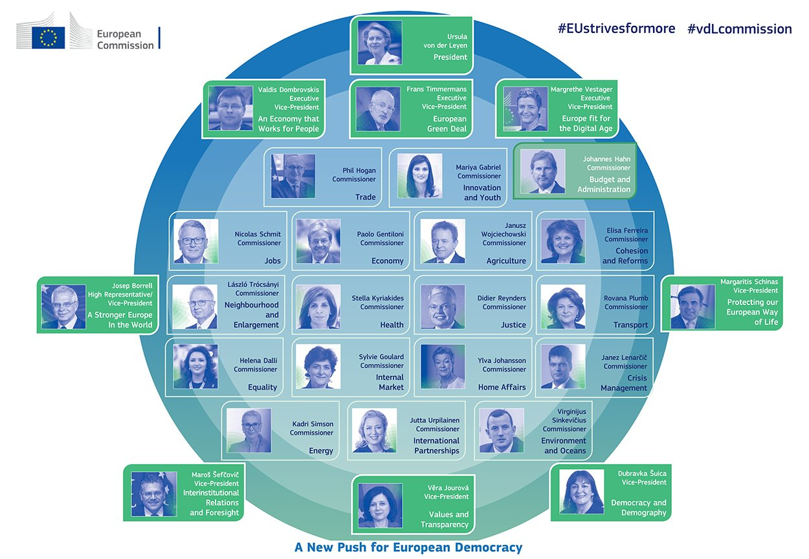

New Set-up

Slide 3
EFBS relevant Commissioners

Slide 4
Most relevant changes
Three Executive Vice-Presidents working on the biggest challenges for the EU while overseeing specific directorates:
  Digitisation (Vestager) – DG COMP
  Environment (Timmermans) – DG CLIMA
  Economy (Dombrovskis) – DG FISMA

Slide 5
Gender and political group balance
13/27 Commissioners are female
S&D 10 (ES, FI, IT, LU, MA, NL, PT, RO, SK, SW)
EPP 9 (AT, BG, CR,CY, DE, EE, HU, IE, LA)
Liberal 6 (BE, CZ, DK, ES, FR, SL)
ECR 1 (PL)
Greens 1 (LI)

