Slide 1
THE ITALIAN BANKING LANDSCAPE:
(the country & the banks: latest trends and the residential mortgage market)
ANGELO PEPPETTI
October 5th 2018

Slide 2

Index
Overview
Key features of Italian banks
Lending: trend and risk
Non-performing loans
Mortgage market

Slide 3
Fiscal efforts and measures implemented from the beginning of the crisis ensure economic recovery and consolidation of public finances in Italy
Recovery in Italy is underway and
based on solid foundations
The outlook is positive: the economy is on a solid footing, GDP growth increased in 2017, rising to 1.5% from 0.9% in 2016. It is expected to moderate in 2018 and 2019 but to remain positive and higher than 1%.
Public finances under control:
  low deficit: deficit consistently below 3% of GDP
  high primary surplus
  Debt, even if still higher than the EU average, has increased considerably less than other countries over the 2009-16 … and the Debt/GDP ration is going down (from 2017)
Macroeconomic environment and political uncertainty are putting under discussion the Italian debt sustainability, but there are relevant reasons not to be overly worried (see following charts)

Slide 4
The Italian outlook is improving faster than expected. So far the outlook remains favourable
Italian public finance outlook based on unchanged legislation
(Italian Government projections as at April 2018)
Real GDP growth
Deficit/GDP
1.5%
1.5%
1.4%
1.3%
0.0%
1.0%
-
0.9%
0.8%
-
0.1%
1.6%
-
2.3%
-
-
2.5%
2.6%
-
3.0%
2014
2015
2016
2017
2018
2019
2020
2014
2015
2016
2017
2018
2019
2020
Primary balance/GDP
Public Debt¹/GDP
3.4%
131.9%
131.5%
132.0%
131.8%
2.7%
130.8%
1.9%
128%
1.6%
1.5%
1.5%
1.5%
124.7%
2014
2015
2016
2017
2018
2019
2020
2014
2015
2016
2017
2018
2019
2020
(1) Including the Italian share of loans to Member States (bilateral or through EFSF) and the capitalization of the ESM. As at year-end 2017 the whole amount is equal to €58.2 billion (of which 43.9 bln for bilateral and EFSF loans) and 14.3 for he capitalization of the ESM. (2) Economic and Financial Document (DEF)” update
Source: ABI on Italian Government’s «Economic & Financial Document (DEF)» - April 2018, Istat
Source: ABI on Istat
Notes:
Even if Italy’s economy is still expanding at below the average rates recorded in the other euro-area countries, GDP growth gained strength last year, reaching 1.5% (exceeding the expectations of the main forecasters).
Macroeconomic policies were still the main driver but growth is increasingly self-sustained. Demand reflected the positive performance of consumption and, especially, investment, which rose by 3.8 per cent, though it is still far from pre-crisis levels. Increased capital formation, which was lacking in the early years of the expansionary phase, is laying the groundwork for a continuation of growth.
Investment in capital goods benefited from tax breaks, incentives for technological innovation, favourable borrowing conditions, and the gradual increase in firms’ confidence in the outlook for demand. Growth in consumption was partly attributable to that in employment, which in turn was driven by the measures supporting labour demand. Unemployment actually decreased from the peak of just under 13 per cent recorded in 2014 to about 11 per cent.
The expansion in production was widespread across almost all sectors: value added accelerated in manufacturing and services and posted its first significant increase in construction since 2006. This was accompanied by a recovery in the demand for loans, supported by low interest rates. Credit access conditions improved, though difficulties persist for small businesses and construction firms, which still present higher risk.
Overall, consumer price inflation returned to positive territory in 2017, reaching 1.3 per cent, but it weakened in the early months of 2018. The core component has remained below 1 per cent since last autumn. Wages and productivity both recorded modest growth. Italian firms have retained the competitiveness gains achieved in recent years.
In the early months of 2018, in Italy too there were signs of a slowdown in manufacturing and of a slight decrease in business confidence indices. The prevailing view is that this is a temporary setback; industrial production appears to have recovered somewhat since March. A scenario of moderate growth and gradually rising inflation remains the most probable one. However, downward risks have increased, also in connection with international developments.
The effects of a less expansionary monetary policy would be moderate also thanks to the low indebtedness of households and to the reduction in that of firms, the limited exposure of financial intermediaries to the consequences of a rise in interest rates, and the high average residual maturity of the public debt, which currently stands at more than seven years.

Slide 5
Italian banks in a nutshell
italian banking Sector on a recovery path. Following the precautionary recapitalisation of MPS and the orderly liquidation of Banca Popolare di Vicenza and Veneto Banca, headline risks have been removed. Favourable macro environment is supporting improvments in credit quality and banks soundness & profitability.
Lending to private sector growing AS OF 2016. In July 2018 loans to households and firms (net of repos and taking into account securitisation of NPLs) grew at around 2.6% YoY.
Credit risk below the pre-crisis level. The flow of new non-performing loans (NPLs) has been decreasing since 2014. It is now about 1.7% of total loans, below the pre-crisis average.
NPL stock diminishing at a remarkable pace. Banks are selling large amounts of NPLs in the market. Including the sales that will be completed in the next months, by mid-2018 the volume of NPLs net of provisions will amount to around €120 billion (6.8% of total loans). The gross NPL ratio stands at 13.4%, against over 18% in 2016.
NPL ratio expected to DECLINE at ACCELERATED PACE: in our June 2016 forecasts (based on 2015 year-end data) we expected NPL ratio at 2020 lower than 10%. Latest actual figures (Dec. 2017) show the ratio is declining more quickly than we expected. In our updated forecasts (July 2018), gross NPL ratio is expected to fall below 10% by mid 2019 and at around 6% by year end 2021.
coverage ratio increasing: it now stands at about 53% for total NPLs and 65% for bad loans; the implict recovery rate on bad loans is 35%, well above the effective recovery rates (about 43% in average for all the NPL position closed between 2006 and 2015).
prudential capitalization levels continue to rise: common equity tier 1 ratio standed at around 13.8% at year end 2017, up from 10.4% in 2016.
Exposure to the domestic sovereign around 9.5% of total assets
Profitability growing: ROE increased to 4% in 2017 net of extraordinary costs and revenues (reported ROE was over 7%). Annualized 1Q 2018 ROE increased at around 9%.
Restructuring & Consolidation going on: 300 cooperative banks will soon form 3 large banking groups. The largest «banche popolari» were transformed into joint stock companies. All in all, the sector is less fragmented than often claimed: around 115 groups and independent banks in total.

Slide 6
Despite the intensity of the crisis, public interventions in favor of the banking sector in Italy were much lower than in other large European countries
Recapitalisation measures* to support banks
(2008-2016 cumulated data, bln €)
Recapitalisation measures* to support banks
(2008-2016 cumulated data, as a % of 2017 GDP)
(*) 2008-2016 cumulated data referred to State recapitalizations used
Source: ABI on European Commission «State Aid scoreboard 2017 – Aid in the context of the financial and econoimic crisis»

Slide 7
Index
Overview
Key features of Italian banks
Lending: trend and risk
Non-performing loans
Mortgage market

Slide 8
Business mix traditionally oriented to lending, unlike other European banks more exposed to finance
Figures referred to a sample of 80 large EU banking groups
(ABI on banks balance sheets and EBA trasparency exercize figures as at June 2017)
1
2
As at May 2018 Italian banks exposure towards domestic sovereign was 361 bln € (about 60 bln less than 2 year before), which is 9,6% of banks total assets³
(1) Loans do not include exsposure to banks.(2) Domestic exposure to sovereign plus foreign sovereign exposure (3) Note that banks and banking groups sovereign on assets ratios are not perfectly comparable for accounting reasons ((inter-bank assets between institutions belonging to the same group are eliminated at the consolidated financial statements level))

Slide 9
Index
Overview
Key features of Italian banks
Lending: trend and risk
Non-performing loans
Mortgage market

Slide 10
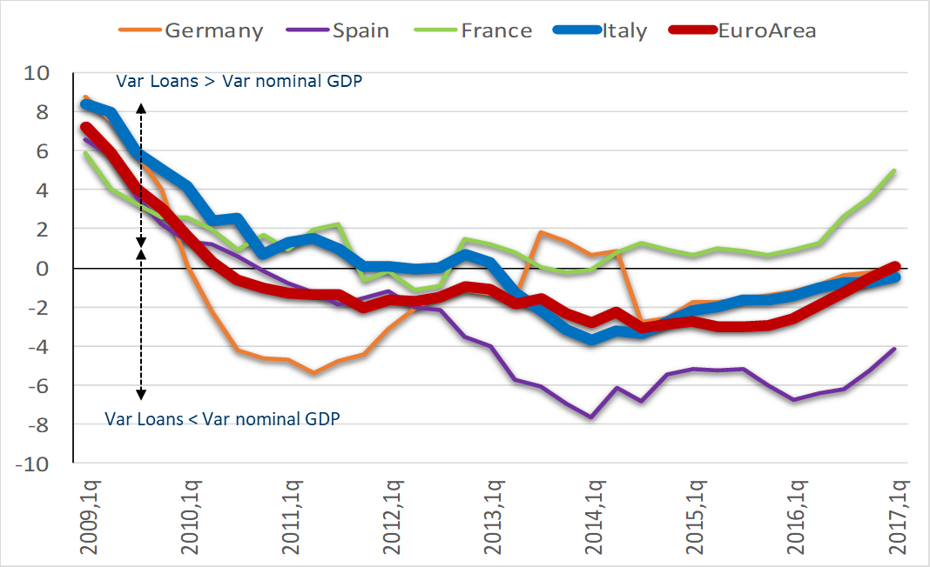
Lending evolution is in line with the GDP growth, as in the main EU countries (but much better than others such as Spain)
’’Loans to Nominal GDP’’ ratio evolution
(percentage variation; YoY, quarterly data)
Var Loans > Var nominal GDP
Var Loans < Var nominal GDP
Source: Abi on ECB data and Eurostat
Source: ABI on ECB and Eurostat data

Slide 11
Loans growth mainly due to the positive evolution of credit risk, which is driven by the recovery of the economy
Loans risk evolution in Italy*
(New NPL/loans; referred to total loans to households & firms)
Firms
Total
2.6%
1.7%
Households
1.2%
(*) Annualized quarterly flow of adjusted NPLs (past-due by more than 90 days, other NPLs and bad loans) in relation to the stock of loans net of adjusted NPLs at the end of the previous quarter. Data seasonally adjusted where necessary.
Source: Abi on Bank of Italy data
Notes:
I flussi in ingresso di nuovi crediti deteriorati sono ormai inferiori ai livelli pre-crisi. In rapporto al totale dei finanziamenti, il flusso di nuovi NPL è sceso su livelli inferiori a quelli precedenti la crisi finanziaria ed ora è pari a circa l’1,7%. E In prospettiva ci si attende un ulteriore miglioramento del quadro di rischio, con riflessi positivi sullo stock di NPL, che continuano a calare. …

Slide 12
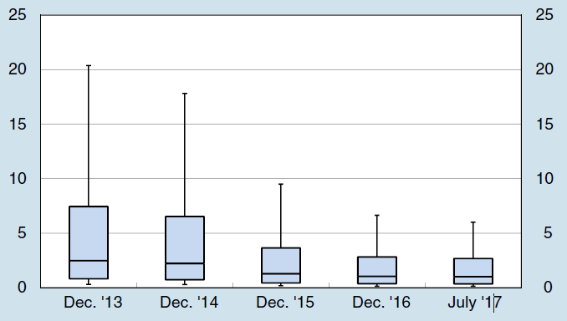
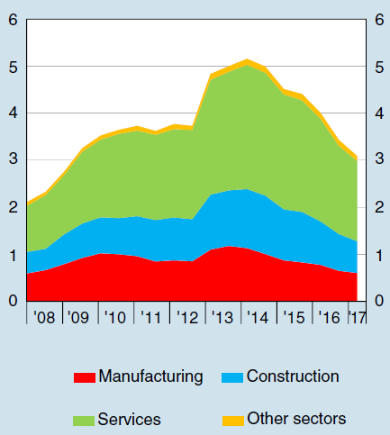
Italian firms’ financial situation is improving as well as firms ability to repay loans : the probability of default and the number of bankruptcy proceedings have significantly declined
Distribution of the probability of default (1)
(12-month percentage changes)
New bankruptcy proceedings (2)
(half-yearly data; thousands)
The probability of default is estimated over a 12-month horizon on an open sample of non-financial companies resident in Italy that includes, for each reference date, all the firms for which balance sheet and Central Credit Register data are available and which have not yet defaulted. The graph shows the 90th, 75th, 50th, 25th and 10th percentiles of the distribution for each year.
The data refer to active companies that submitted their annual financial statements at least once in the three years before the start of the bankruptcy proceedings.
Source: ABI on Bank of Italy data

Slide 13
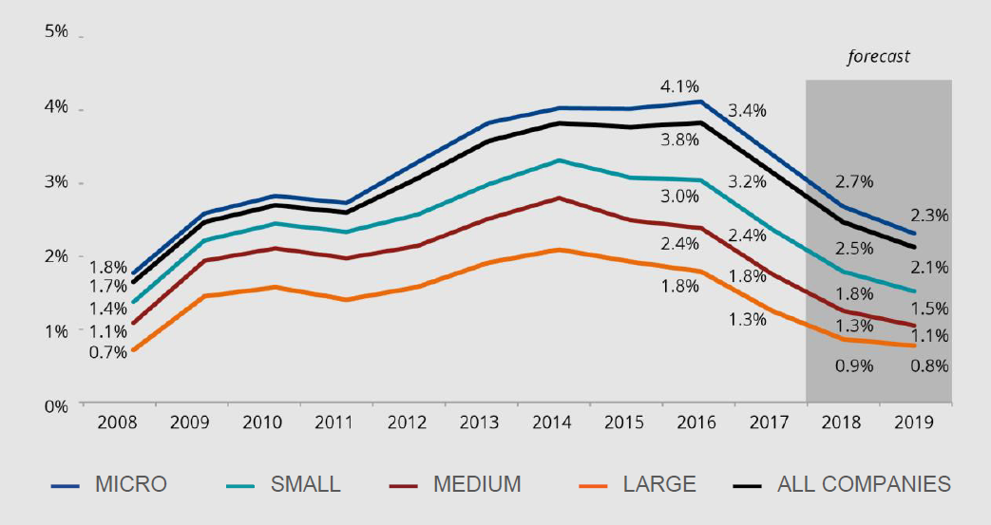
Looking forward: credit risk is expected to further reduce (at all firms size)
New bad loans as a percentage of total loans to non-financial companies in Italy
(Annual influx of bad loans, adjusted and expressed as a percentage of total loans)
Source: Abi-Cerved estimates and forecasts

Slide 14
Index
Overview
Key features of Italian banks
Lending: trend and risk
Non-performing loans
Mortgage market

Slide 15
The causes of the NPL issue: enforcement procedure length is a key factor
Causes of NPLs
In Italy 80% of NPLs growth explained by macro/country factors (Real GDP, enforcement procedure length; interest rates spread) compared to 50% on average in Europe
In particular, enforcement procedure length is key: it explains 50% of NPLs growth in Italy
Source: ABI

Slide 16
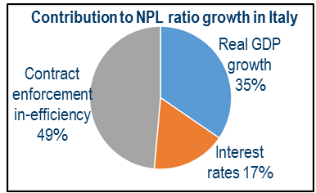
Improvement in the civil justice efficiency is a key priority, as its slowness was the main responsible of the NPLs increase in Italy
What if
simulation
NPL ratio 2014
(our estimates¹ vs. actual figure)
Country-specific determinants of NPLs in Italy (Average value)
Factors modified in the simulation | from | to | Explanation
Real GDP growth | -1.3% | 0.40% | GDP growth in line with the Euro Area f/2008 t/2014
Interest rate on BTP | 4.3% | 2.2% | Spread vs. Bund limited to 30 p.b. from 2010 to 2014
Contract enforcement efficiency | 1224 days | 584 days | Contract enforcement efficiency equal to the European mean f/2008 t/2014
-11.8 pp
NPLs evolution since 2008 mainly determined by lower GDP growth, higher Sovereign benchmark rate and lower contract enforcement efficiency. Using Abi econometric model, we find that for the Italian banks the cumulative impact of these three factors explains the 80% increase in NPLs (around 12 pp) - of which almost the half is due to the Contract enforcement in-efficiency - as compared to 50% in the other European countries
1) The estimated NPL ratio is equal or lower than the actual NPL in all the countries as we apply the European Average (for one or more of the 3 key variables) instead of the country actual figure only in case the change produces a positive effect. Indeed, in each year observed, we divide the countries into two groups: (i) those with GDP growth higher than the EA; (ii) those with GDP growth lower than the EA. Then, we assign the EA GDP growth solely to the second group. Moreover, we assign, solely to the stressed countries (i.e., GIPSI), the Germany benchmark rate plus 30 bp. Finally, we assign the mean value of EA contract enforcement efficiency to all countries that have a value of this index higher than the average (i.e., Greece, Ireland, Italy and Slovenia).
Source: ABI based on “Non-Performing Loans in the Wake of Crises: What Matters for Large European Country vs. Bank Determinants” ABI Research Paper, TEF Special Issue N. 4, March 2016

Slide 17
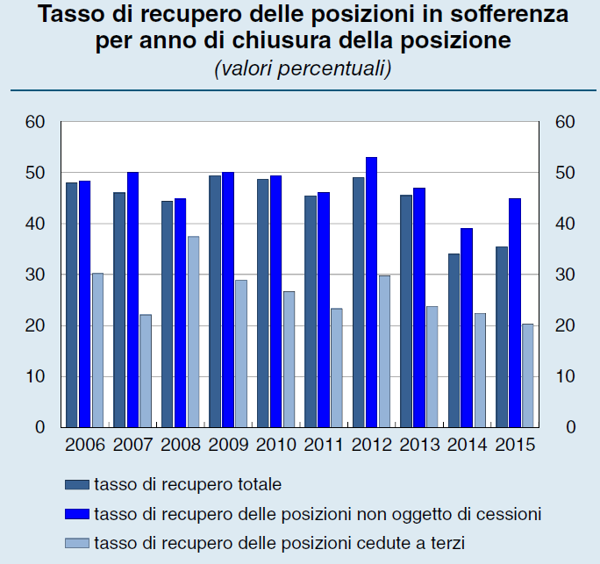

Current coverage ratios aligned with effective recovery rate of bad loans. Recovery rate on ordinary closed positions significantly higher than those on positions sold
Amounts of NPLs and coverage ratios in Italy
(by class of NPLs; %; December 2017)
Actual recovery rates of Bad loans in Italy
(total and by type of recovery procedure)
 | December 2017
 | Coverage
Loans | 8.1%
NPLs total: | 52.7%
- Bad loans | 64.4%
- Unlikely to pay | 33.9%
- Past due loans | 21.4%
43%
Implicit recovery rate:
36%
Average rate of recovery on all the closed position
Average rate of recovery on ordinary closed positions
Average rate of recovery on positions sold on the market
The average rate of recovery on bad loans between 2006 and 2015 was 43% (which corresponds to 57% of losses, a percentage in line with the current average coverage rate (64.4% at December 2017)
Recoveries on ordinary closed positions are significantly higher (around 45% in 2015) than those recorded on positions sold on the market (around 20%)
Source: Bank of Italy data

Slide 18
In particular, Bad loans (“sofferenze”) down to 40.1 bln €, 55% less than the pick touched in November 2015 (88.8 bln €) and 54% less than the amount at year end 2016
Italian net bad loans (sofferenze)
(total Italian banks; July 2015 – July 2018; bln €)
88.8
(Pick; Nov 2015)
-55%
86.8
(Dec 2016)
-54%
40.1
(July 2018)
Source: ABI on Bank of Italy data

Slide 19
The expectation on the NPL issue: NPLs ratio estimated to speedily return to manageable value
Expectations
NPLs ratio expected to speedily return to manageable value, even in the context of a modest growth and in the absence of extraordinary acceleration in NPL disposals
Improvement in civil justice efficiency is a key priority: positive impact of recent reforms begin to be visible (on procedures length and on the Bid/Ask price gap)
ECB guidelines welcome. They also recognise that: i) NPL issue needs time to be managed; ii) internal management is an options
impact on IBR banks’ LGD calculation of extraordinary NPL disposal (or M&As) to be sterilised

Slide 20
Index
Overview
Key features of Italian banks
Lending: trend and risk
Non-performing loans
Mortgage market

Slide 21
NEW ISSUANCE OF RESIDENTIAL MORTGAGE LOANS
New issuance of mortgage loans to purchase home
(billion of euro)
Data at the end of year
43,5
53,8
52,2
Source: ABI

Slide 22
Stock of Residential Real Estate mortgage loans on GDP in EU
Source: EMF

Slide 23
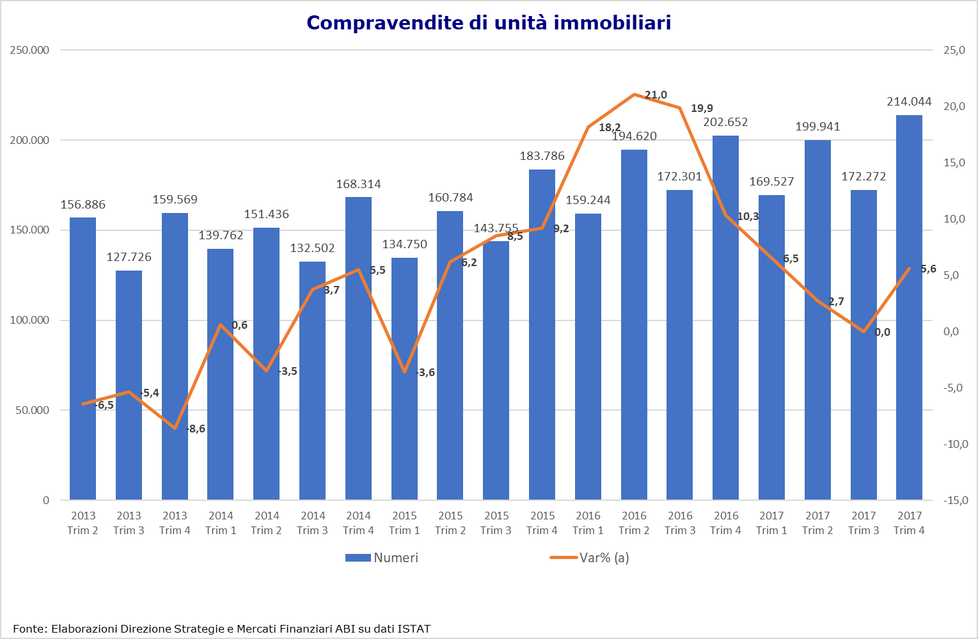
Increase of Italian household transactions…
Number of real estate transactions in Italy
Numbers
Yearly variation (%)
Source: ABI on Istat data

Slide 24
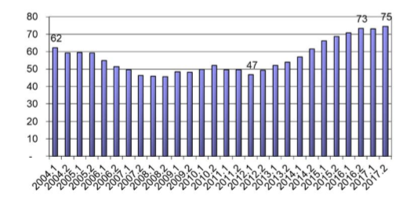
… in line with the increase of Italian householders affordability
% of Italian families who can afford to purchaase an house
Source: OMI, Istat and Bank of Italy

Slide 25
Main Topics of Italian Residential Mortgage Market
Size | 126.000
Maturity | > 20 y
LTV | 71%
Trasactions funded by loans | 50%
Source: OMI, CRIF, Prometeia, Assofin

Slide 26
THANK YOU FOR YOUR ATTENTION
a.peppetti@abi.it

