Slide 1
Eba call for advice on basel iii: state of play
Olli Castrén | Head of Economic Analysis and Impact Assessment, EBA
EFBS Meeting - Brussels 21 March 2019

Slide 2
Basel III revisions: reducing undue RWA variability
A more granular SA to credit risk
New asset (and sub-asset) classes: specialised lending, high quality infrastructure lending, income producing real estate, equity, covered bonds. SMEs, […]
New operational risk framework
New Standardised Measurement Approach: replaces all existing approaches
Output floor
RWAs never lower than 72.5% of standardised equivalent RWAs
Leverage ratio
All banks: Revised LR exposure measure
Transitional implementation (2022-2027) and transitional +25% cap on impact
G-SIIs: LR surcharge = ½ of G-SII capital buffer
Fundamental Review of the Trading Book & CVA
June 2019 CfA : FRTB as per January 2016 BCBS framework
New methods: loan splitting for real estate, no sovereign support within bank risk weights […]
New risk weights: exposures to banks, exposures to corporates […]
AMA no longer available
September 2019 CfA: update reflecting final BCBS FRTB framework (may not include final CVA revisions)
Constraints IRB to credit risk
A-IRB no longer available for: Large Corporates and Banks
New risk parameter input floors
New treatment of guaranteed exposures
National discretion on role of historical losses

Slide 3
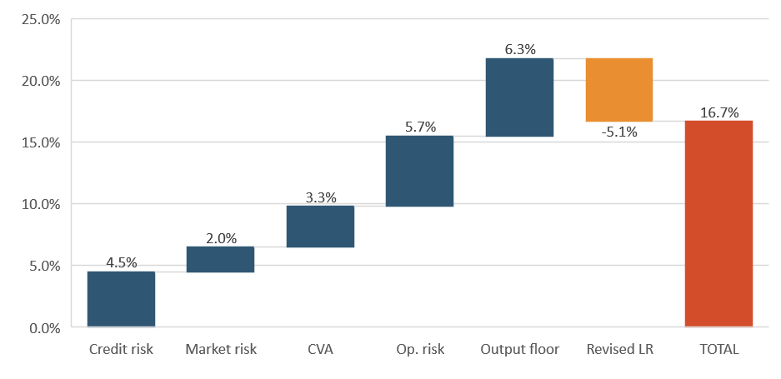
An appetizer: impact of the reform as of October 2018 EBA Basel III monitoring report
Overall impact of full implementation of the final Basel III (2027), in % change of Tier 1 MRC, ‘All banks’
Capital shortfalls
Source: October 2018 EBA Basel III Monitoring exercise report (reference data Dec 2017)
Source: October 2018 EBA Basel III Monitoring exercise report (reference data Dec 2017)
  Main drivers: output floor and operational risk
  Largest banks more impacted: G-SII +25.4% MRC, Group 1 +18.7% MRC, Group 2 +3.8% MRC
  Note: Systemic Buffers and P2 not included!

Slide 4
Key findings by risk category
Operational risk (+5.7%)
  Basel III national discretions:
    Loss materiality threshold at 100k (instead of 20k): +4.5%
    Discretion of setting the ILM = 1 (instead of bank-specific): +1.4%
CVA risk (+3.3%)
  Basel III scenario excludes EU CVA exemptions: if exemptions kept impact will be lower
Leverage ratio (-5.1%)
  LR-constrained banks do not ‘pay’ part of the RWA-driven increase in capital: this explains the LR negative offset result at aggregate level (-5.1%)
  The leverage ratio Tier 1 MRC in the sample increases when looking at it in isolation(+5.1%), due to the introduction of the G-SIIs surcharge

Slide 5
More comprehensive assessment under way: the Call for Advice (CfA)
12 Oct 18
QIS submission deadline for large/medium banks
9 Nov 18
QIS submission deadline for small banks
13 Aug 18
Launch QIS
9 Nov 18
Launch Qualitative survey
11 Jan 2019
Deadline for qualitative survey
End-Jun 19
CfA Report Publication

Slide 6
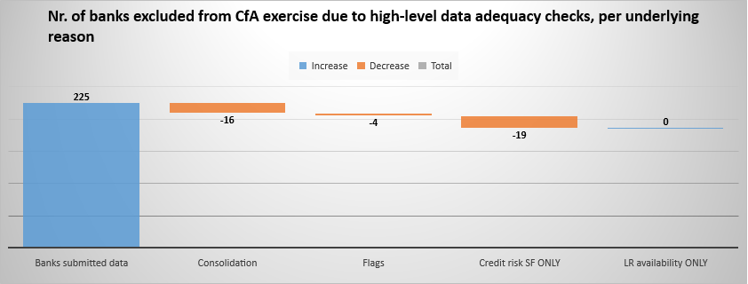
Data collection status – QIS and Survey Samples
186 banks in the QIS cumulative analysis (as of today)
Why are some banks excluded?
NOTE: Banks excluded due to ‘consolidation’ (subsidiaries of EU parents) will inform the Business Model Analysis
178 banks submitted the Qualitative Questionnaire
25 ECAIs submitted the Qualitative Questionnaire
* CR SF: Credit risk scaling factor

Slide 7
Analytical elements of the CfA (non exhaustive)
Capital requirements
  Pillar 2 included in the impact calculation (besides P1 and buffers)
Proportionality and business models
  Impact assessed as per Large / Small non-complex / Other CRR2 clustering
  Impact assessed per business model
Level of consolidation
  QIS: highest level of EU consolidation
  Subsidiary analysis: O-SII subsidiaries + Qualitative Questionnaire on impact at subsidiary level (largest subsidiary per business model in the Banking Group)
Marginal quantitative impacts
  ‘All but one approach’: impact of individual provisions assessed vs. overall package
Macroeconomic impact
  Collaboration EBA-ECB
Qualitative analysis (survey)
  Policy elements that cannot be assessed via QIS and input from ECAIs

Slide 8
Main areas of focus in the CfA (non exhaustive!)
Credit risk
  Credit Ratings (SA)
    Overall: ECRA (ratings allowed) vs SCRA (ratings banned)?
    Corporate exposures: mixed approach? (EU vs. US, IG vs. non-IG)
    Real estate: loan-splitting vs whole loan
  CRR/CRR2 SME and infrastructure supporting factors: interaction with Basel III new risk weights for SMEs and high quality infrastructure lending?
Operational risk:
  Role of historical losses – ILM discretion: bank-specific or flat =1?
  Materiality threshold discretion: 20K or 100K?
Output floor
  Interaction with Pillar 2 and macro-prudential buffers
    What are the overlaps? Need to reconsider P2 breakdown
    Is RWAOF the new measure of risk feeding in throughout?
  Interaction with Leverage Ratio: overall backstop to RWA variability?

Slide 9

Thank you for your attention!

